Slide 1
Breathing Analysis: Breathing Rate and Apnea detection in unrestrained mice
Christopher Ward
June 2016

Slide 2
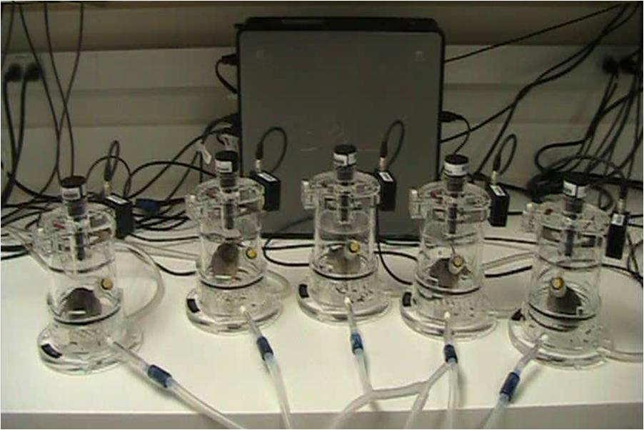
Breathing Signal
A
During whole body plethysmography…
– As a mouse inhales, the displacement of air by its body is slightly greater than the volume of air inhaled. This increases the pressure in the chamber/forces air out of the chamber. As the mouse exhales, the displacement difference causes pressure change/air flow in the other direction. The volume of air pushed into and out of the chamber is ~10% of the actual volume inhaled by the mouse. The airflow is affected by several factors including body temperature, ambient temperature, humidity, and airway resistance.
B
TE
TI – Duration of Inspiration (Inhalation)
TE – Duration of Expiration (Exhalation)
TT – Duration of Total Breath
PIF – Peak Inspiratory Flow
PEF – Peak Expiratory Flow
iTV – Tidal Volume (inhalation)
eTV – Tidal Volume (exhalation)
PIF
iTV
Air Flow
<-Exhalation| Inhalation->
eTV
PEF
TI
TT

Slide 3
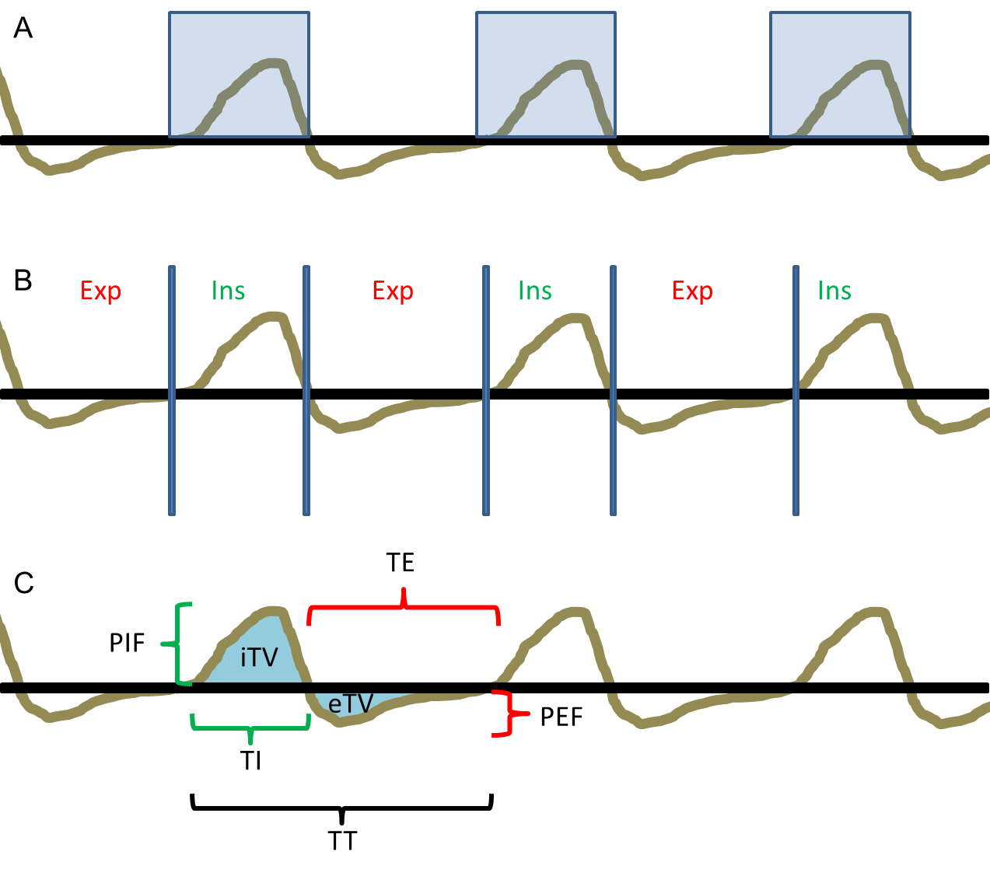
Breath Calling Algorithm
Find the regions above the baseline threshold
Use the threshold crossings to distinguish between inhalation and exhalation
Interrogate the identified breaths for the intra-breath measures used in later analyses

Slide 4
Defining Motion: Pixel Intensity Changes
Frame #1
Frame #2
Absolute Value Difference Between Frames 1 and 2

Slide 5
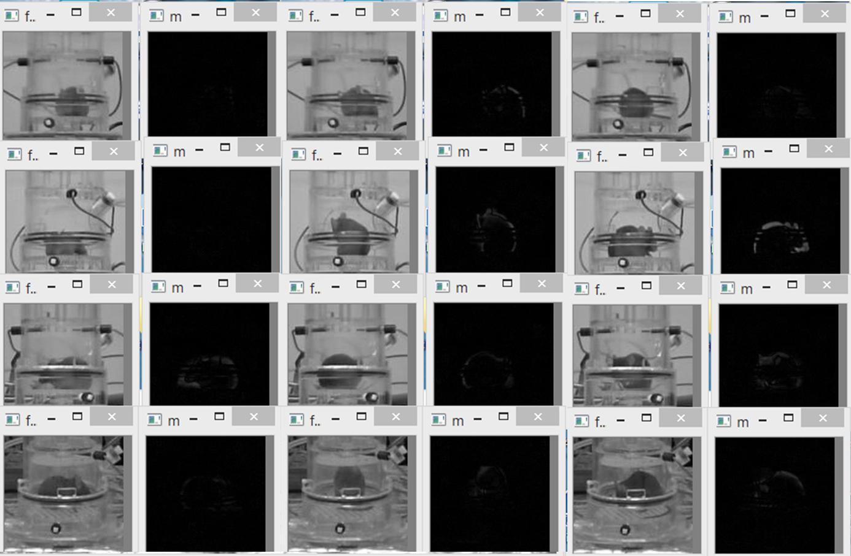
Some mice moving…

Slide 6
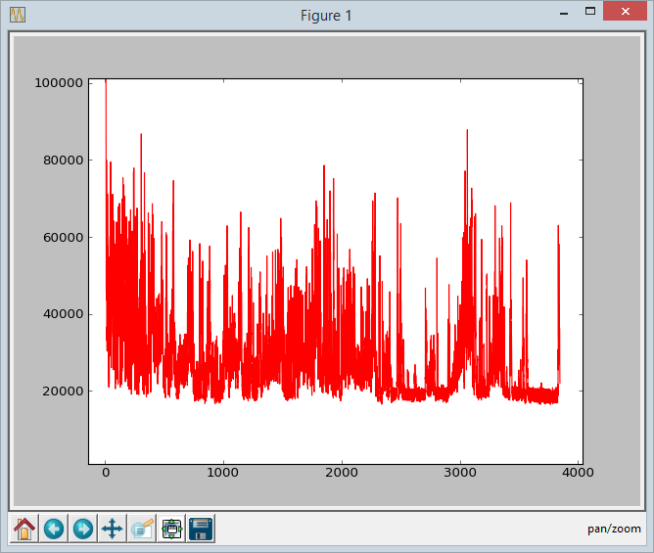
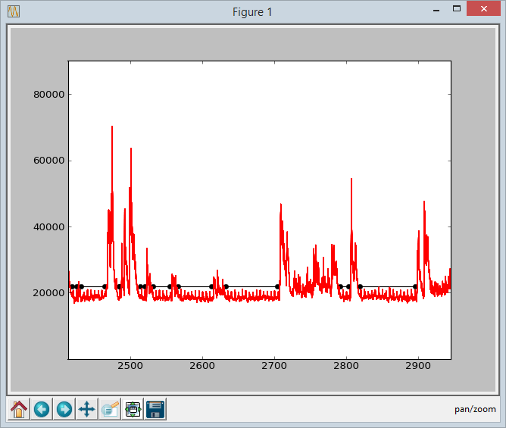
Defining Motion: Segments where the pixel intensity changes are low are called as ‘calm’ segments. We are interested in the mouse breathing during these segments.
Calm Segments
Activity Score (A.U.)

Slide 7
Excel Macros and Python Scripts
Inputs Needed From Ponemah
.ascii file with breathing signal, Video Recording to filter for ‘Calm’ segments, .xlsb file to help generate Animal List
Excel
Batch save macro
[convert binary .xlsb to regular excel .xlsx]
Python
Excel Grabber
[collects mouse info from the Ponemah output to help generate an “animal list” for animals that were recorded]
Movement Quantification
[scores movement]
Calm Segment Extractor
[defines calm segments]
BreathCaller
[calls breaths and outputs summarized breathing data]
TracePlotter
[creates graphs of breathing around called apneas]
wardcode
[provides some functions used by the other scripts]

Slide 8
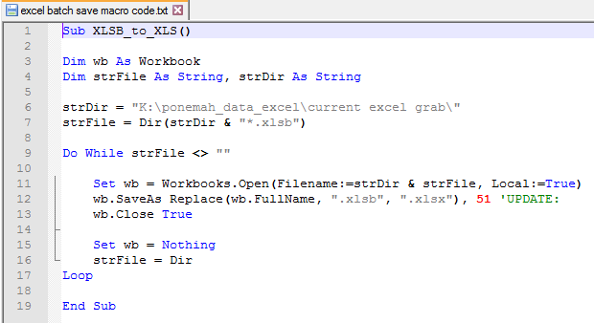
Excel Macro – batch save
Place all of the ponemah .xlsb output files into their own separate directory
Open ‘batch save macro book.xlsm’
Update the strDir variable to point to the directory containing the .xlsb files
Run the Macro
The directory should now include .xlsx versions of the original files placed in it

Slide 9
Python - Excel Grabber
Run using python 3.4 or newer
(dependent on openpyxl library)
Current version is ‘excel grabber.py’
User inputs needed:
Suffix for video files (default value should work for current set-up ‘_Video 1_1.avi’)
Directory containing the recently converted .xlsx files [performed with graphical interface]
Filename to use for ‘Animal List’ output by the script [performed with graphical interface]

Slide 10
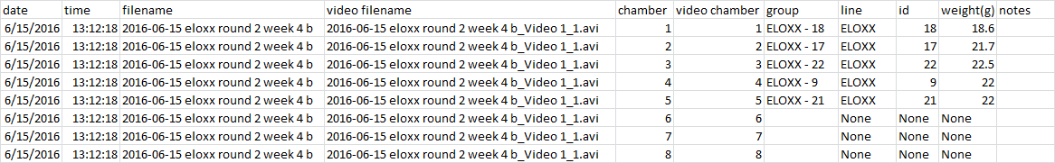
Animal List
Double Check the Automatically Generated Animal List against the plethysmography logs
Typos in animal numbers/lines/weights may need to be corrected
The Excel Grabber Script assumes a standard breathing protocol was performed – deviation may require updates to video file names, etc.

Slide 11
Python - Movement Quantification
Run using python 3.4 or newer
(dependent on opencv and numpy libraries)
Current version is
‘movement quantification py34 v8.py’
User Inputs:
Video files for analysis [selected by graphical interface]
Output File Name [selected by graphical interface]
Analysis Settings…

Slide 12
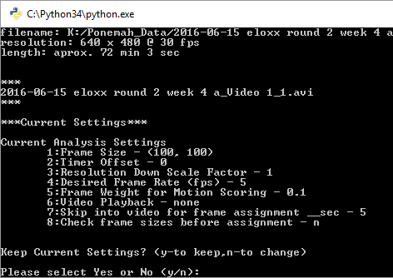
Python - Movement Quantification Analysis Settings
Default options should work for current protocol
Frame size: the size of the ROI that will be selected around each mouse
Timer Offset: allows adjustment if video timestamp does not match breathing signal time stamp
Resolution Down Scaling: reduces the resolution of the video during analysis (may trade speed for sensitivity)
Desired Frame Rate: sets the time between frames that will be sampled for scoring motion
Frame Weight: sets the amount that a previous frame will contribute to the average background that the current frame is compared against (helps to address signal noise)
Video Playback: allows viewing of raw and motion scoring video
Skip for frame assignment: allows for skipping into the video before assigning mouse positions in case cameras are adjusted soon after the start of filming
Check frame sizes before assignment: allows the user to reset Frame size if needed after seeing video

Slide 13
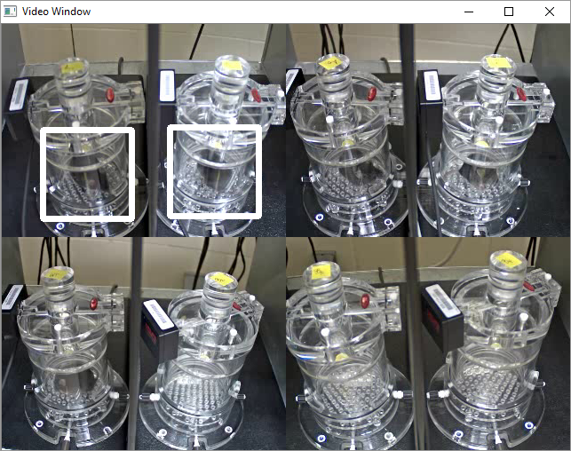
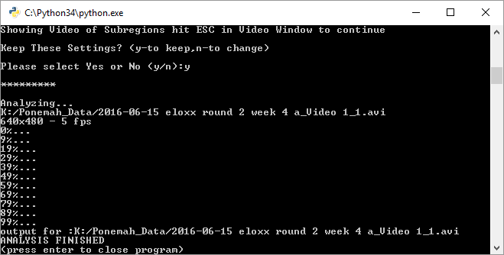
Python - Movement Quantification ROI Selection
Assign Mouse positions
Double Click on the center of each ROI you assign (we currently assign ROI’s to each chamber even if empty)
Press ‘Esc’ when done
Demo Video will display to show the ROI’s selected
Press ‘Esc’ again to stop ROI preview
Accept the Settings and the analysis will be performed

Slide 14
Python – Calm Segment Extractor
Run using python 3.4 or newer
(dependent on matplotlib and numpy libraries)
Current version is
‘calm segment extractor py34 v4.py’
User Inputs:
Motion Scores from video analysis [selected by graphical interface]
Animal List from Excel Grabber [selected by graphical interface]
Calm Segment Output File Name [selected by graphical interface]
Analysis Settings…

Slide 15
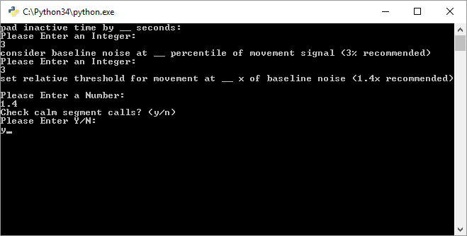
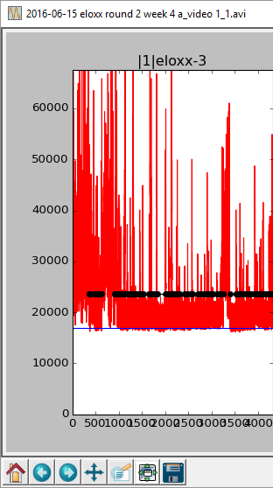
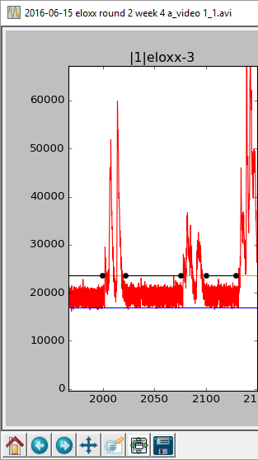
Python – Calm Segment Extractor Analysis Settings
Default options should work for current protocol
Pad inactive time: time at boundaries of calm vs active segments to exclude from calm segments [3 seconds recommended]
Baseline noise: the level used to establish pixel changes not due to motion [3 recommended]
Relative Threshold for Movement: multiplier of baseline pixel changes used to define calm vs active states [1.4 recommended]
Check calm segment calls: allows user to preview calm segment calls and modify settings if needed

Slide 16
Python – Breathcaller
Run using python 3.4 or newer
Current version is
‘wardbreathcaller py34 v3.py’
User Inputs:
.ascii files with breathing signal data [selected by graphical interface]
Animal List from Excel Grabber [selected by graphical interface]
Calm Segment List [selected by graphical interface]
Analysis Settings…

Slide 17
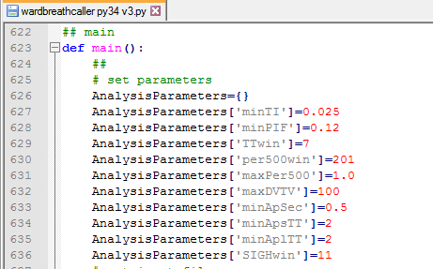
Python – Breathcaller Analysis Settings
Parameters
minTI: minimum time spent inhaling for a breath to be called (used to help call breaths – set at a level that helps address movement/mechanical artifacts)
minPIF: minimum peak inspiratory flow (used to call breaths, lower values may allow better detection of ‘baseline downdrift’ or ‘shallow breathing’ in weak or small/young mice at expense of an increased false positive breath calling rate)
TTwin: size of window for local breath duration calculations for apnea quantification
per500win: size of breath window for maxPer500 filter
maxPer500: max acceptable ration of breaths above 500 BPM (currently set to a very permissible value – lower values may reduce sniffing artifacts)
maxDVTV: max acceptable deviation between inhaled and exhaled TV calculations (currently set to a very permissible value – lower values may reduce sniffing/grooming/movement artifacts)
minApSec: apnea definition based on absolute time
minApsTT: apnea definition relative to overall breath duration
minAplTT: apnea definition relative to local breath duration
SIGHwin: size of breath window for calculating sighs (not yet fully implemented)
Output will be a txt/excel readable file that summarizes the
breathing parameters and apnea frequency.
one row per mouse per file analyzed.

